Slide 1

AMD Ryzen 4th gen Threadripper
January 2022
Presented by:
Chaîmae Mottaki

Slide 2










Table Of Contents
Context
Specifications
Architecture upgrade
Comparison with Intel equivalent

Slide 3

Context
Ryzen 5000 Desktop CPUs | Ryzen 5000 Threadripper CPUs (HEDT)
Gaming, creative work tasks | Processor-intensive tasks: Ex: animation, game dev, streaming+ gaming,…
Small core count (6 to 16) | Large core count (64)
Each individual core is fast | Slowed down cores, otherwise: overheating

Slide 4

Specifications (leak)
Lithography: 7 nm
Number of cores: 64
Core Architecture: Zen 3
PCIe 4.0
Number of Threads: 128
Total cache L3: 256 MB
Memory: Quad-channel DDR4 3200MHz
TDP: 180W

Slide 5
Zen 3 Architecture
Branch Prediction
= helps to predict which instructions to execute next
Improvements:
more bandwidth
quicker recover from misses

Slide 6
Zen 3 Architecture
Cache
= contains the data that needs to be processed very fast
ZEN 2 | ZEN 3
Each core complex: 4 cores | each core complex: 8 cores,
sharing 16 MB L3 cache | sharing 32 MB L3 cache.
→ Better core to core and core to cache communication
→ Lowers the latency
→ Instructions per clock increase of 19%
→ Higher clock speeds

Slide 7
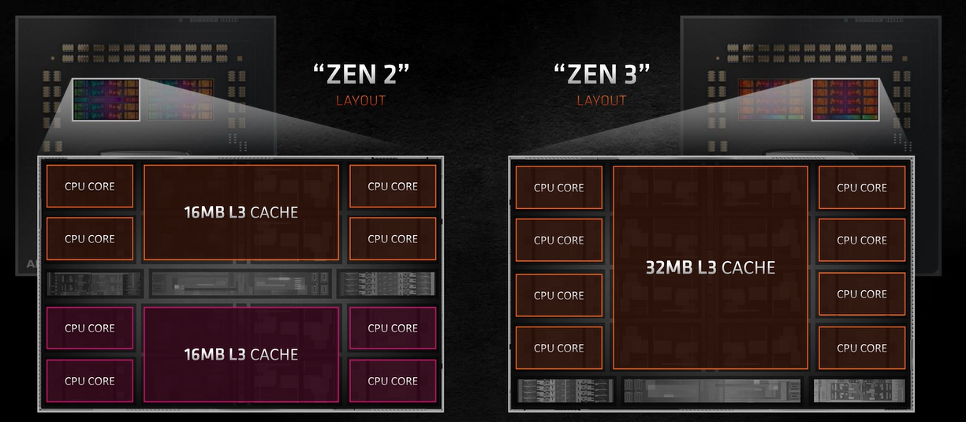
Zen 3 vs Zen 2 Architecture

Slide 8
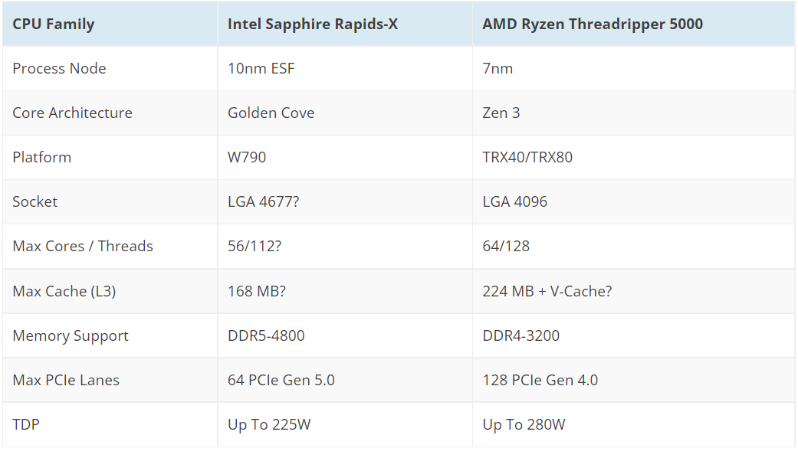
Chagall vs Intel Saphire rapids

Slide 9


Slide 10
Bibliography
https://www.youtube.com/watch?v=Pxn-QOpkrBw&list=WL&index=5
https://www.igorslab.de/en/chagall-lives-at-ryzen-threadripper-pro-5995wx-and-his-4-brothers-with-interesting-technical-data/
https://www.youtube.com/watch?v=8S87KbtleGo
https://thumbs.gfycat.com/BackImpeccableHomalocephale-size_restricted.gif
http://mspoweruser.com/wp-content/uploads/2016/05/AMD-logo2-800x400.png
https://wccftech.com/amd-ryzen-threadripper-5000-chagall-hedt-cpus-allegedly-delayed-to-2022/
https://www.youtube.com/watch?v=X-7naMLoTQE

